Slide 1


International Debt Statistics Analysis
CAPSTONE PROJECT
BY-
S. Vijay Sarangeshwar(192224073)
G. Venkata Balaji (192224083)

Slide 2

Introduction to International Debt Statistics Analysis
International debt statistics analysis involves studying the borrowing and lending activities of countries on a global scale. It provides insights into economic stability, financial risks, and geopolitical implications of debt. By analyzing these statistics, we can understand the impact on global economy and develop informed strategies.

Slide 3
Importance of analyzing international debt statistics
1
Economic Stability
2
Policy Decisions
Understanding debt statistics is crucial for maintaining global economic stability.
Debt analysis informs government policies and international financial decisions.
3
Risk Assessment
4
Investor Confidence
It helps in assessing the risk factors associated with international borrowing.
International debt data impacts investor confidence and financial market trends.

Slide 4



METHODOLOGY
Sources of International Debt Data
Government Agencies
Research Institutions
International Organizations
Official data from national treasury departments and central banks.
Publications and reports by reputable economic research organizations.
Data sets from organizations like the World Bank, IMF, and OECD.

Slide 5
Key Indicators and Metrics Used in Debt Analysis
Debt-to-GDP ratio
Compares a country's debt to its economic output
External debt
Includes loans from foreign entities and governments
Debt service ratio
Measures the ability to meet debt obligations
Interest payments
Amount paid on debt compared to total revenue

Slide 6
Analyzing Trends and Patterns in International Debt
1
Debt Accumulation
Initially, analyze the accumulation of debt over the years to identify long-term trends.
2
Regional Disparities
Examine regional disparities in debt distribution to understand geographical patterns.
3
Economic Impact
Assess the economic impact of debt trends on various sectors and industries.

Slide 7
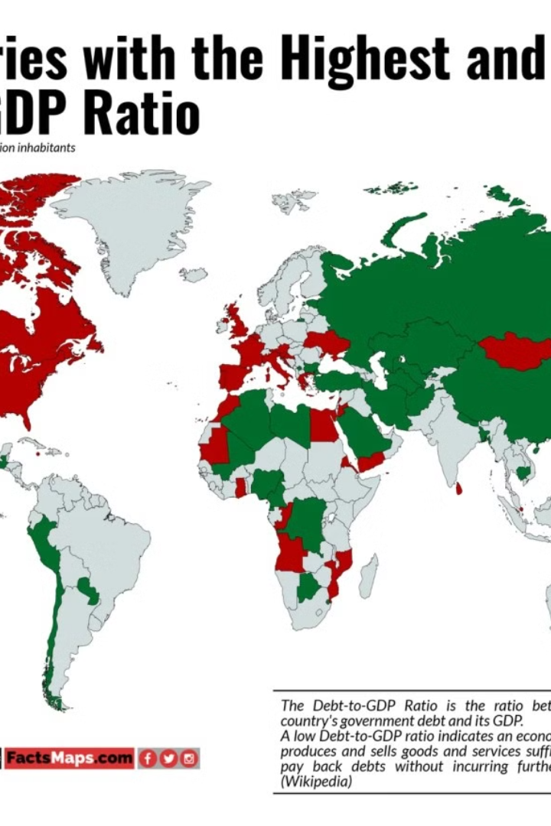
Case Studies of Countries with High and Low Debt Levels
When analyzing international debt statistics, it's essential to examine case studies of countries with contrasting debt levels. By comparing the experiences of nations with high and low debt burdens, insights can be gained into the impact of debt on economic growth and development.
Japan (266.1% of GDP): Japan has the highest debt-to-GDP ratio globally. This is due to several factors, including an aging population, low economic growth, and large government stimulus packages to counter economic downturns. The high debt burden raises concerns about the country's long-term fiscal sustainability.
Estonia (17.2% of GDP): Estonia has pursued prudent fiscal policies since regaining independence in 1991. The country maintains a balanced budget and a low debt-to-GDP ratio. This has helped Estonia attract foreign investment and maintain economic stability.

Slide 8

RESULTS AND DISCUSSION
Understanding the Debt-to-GDP Ratio:
The debt-to-GDP ratio is a key metric for assessing a country's ability to manage its debt burden.
It is calculated as: Debt-to-GDP Ratio = Total Debt / Gross Domestic Product (GDP)
A higher ratio indicates a larger debt load relative to the country's economic output.
Calculating and Visualizing the Ratio:
Calculate the Debt-to-GDP Ratio:
If available, your data might already include this metric.
Otherwise, calculate it using the formula mentioned above.
Consider filtering or grouping the data by country or region for analysis.
Visualization Options:

Slide 9
KEY CONSIDERATIONS
Debt levels alone don't tell the whole story. A country's ability to manage its debt depends on factors like economic growth, interest rates, and the composition of the debt (domestic vs. foreign).
High debt levels can be sustainable if a country has strong economic growth and a credible plan for fiscal consolidation. Conversely, low debt levels can be risky if they are accompanied by weak economic fundamentals.
Countries with high debt levels need to implement sound fiscal policies to reduce their debt burden and improve their long-term financial health.
The image you sent lists Venezuela as having a debt-to-GDP ratio of 165.4%. Venezuela's economic situation is complex, with hyperinflation and a severe recession significantly impacting its debt sustainability.
Debt management strategies need to be tailored to each country's specific circumstances. There's no one-size-fits-all approach.

Slide 10
Implications of international debt on economic growth and development
1
Impact on GDP
Influence on a country's economic output and growth
2
Investment and Infrastructure
Effect on government spending on development projects
3
Financial Stability
Potential impact on a nation's financial stability
Debt Sustainability
4
Assessment of a country's ability to manage debt levels
The implications of international debt on economic growth and development are far-reaching. It directly affects a country's GDP and influences government investment in infrastructure and development. Moreover, it has the potential to impact a nation's financial stability and raises concerns around debt sustainability.

Slide 11




Challenges and Limitations in Analyzing International Debt Statistics
Data Quality
Obtaining reliable and comprehensive data from all countries can be challenging.
Debt Classification
Loading...
Issues with classifying and categorizing different types of debt present complexities.
Political Factors
Political influences can impact the accuracy and transparency of reported debt data.

Slide 12


Slide 13



